Slide 1

What role for biomass power in a clean energy standard?
Mary S. Booth, PhD
Partnership for Policy Integrity
April 2, 2011
Notes:
Introduction;
representing Mary Booth of Partnership for Policy Integrity.

Slide 2
“Biomass energy”
For the purposes of this talk:
  Combustion of wood and other biological materials to produce steam and generate heat and power; or gasification of fuel to drive a turbine.
  Combustion at “direct-fired” plants or as co-firing with coal
  “Biomass” = wood. Few facilities using agricultural residues or energy crops
  Considered “renewable energy”: eligible for same incentives and subsidies as wind and solar power.
  Has been considered “carbon neutral” –now changing

Slide 3
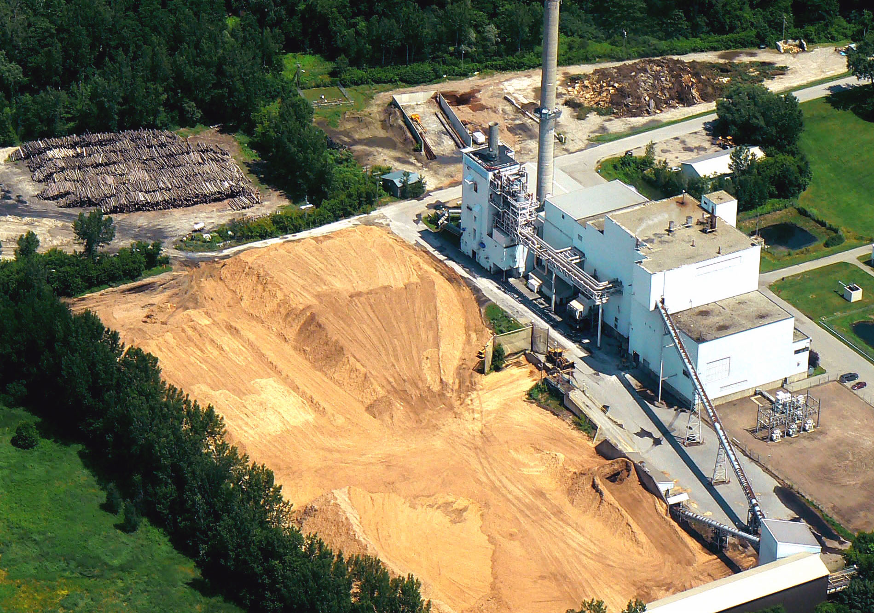
McNeil Power Plant, Burlington, Vermont
Photo: Chris Matera, Massachusetts Forest Watch

Slide 4
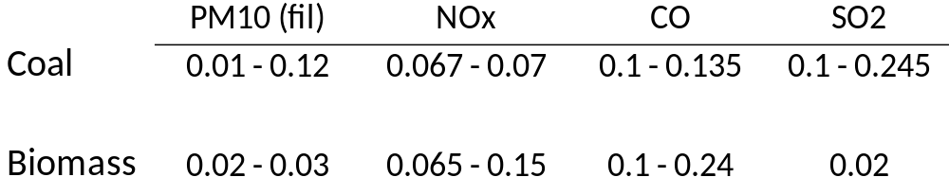
What role for biomass in a “clean” energy standard?
First, what’s “clean”?
Bingaman bill: Carbon emissions only.
PFPI’s position: “Clean” should mean… CLEAN.
Emission rates of top performers listed in EPA’s RACT/BACT/LAER Clearinghouse (lb/mmbtu)
Except for SO2, biomass emits as much or more pollution than coal

Slide 5
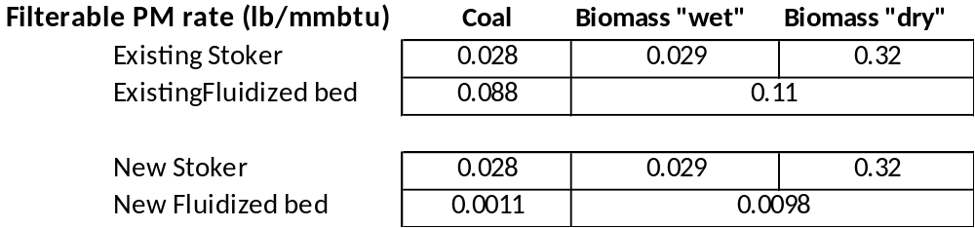
EPA’s “boiler rule” (control of Hazardous Air Pollutants)
Filterable PM: EPA sets higher allowable rates for biomass than coal
Carbon monoxide gap is even larger

Slide 6
Biomass energy is opposed by health organizations
Massachusetts Medical Society resolution: (December, 2009)
“biomass power plants pose an unacceptable risk to the public’s health by increasing air pollution”
American Lung Association Energy Policy: (June 11, 2011)
The American Lung Association does not support biomass combustion for electricity production, a category that includes wood, wood products, agricultural residues or forest wastes, and potentially highly toxic feedstocks, such as construction and demolition waste.
The American Lung Association strongly opposes the combustion of wood and other biomass sources at schools and institutions with vulnerable populations.

Slide 7
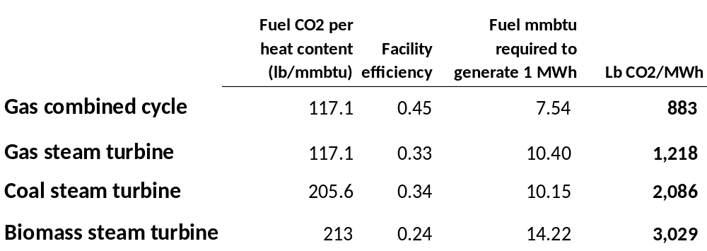
Carbon dioxide emissions from biomass versus fossil fuel power facilities
Biomass plants emit
~50% more CO2 than coal plants
~250% more CO2 than gas plants
(emissions are 340% greater than combined cycle gas plants)

Slide 8
Not controversial that biomass emits more CO2 per unit energy than fossil fuels…
So why has biomass energy been treated as “carbon neutral”?
  The “waste” argument: Materials burned are “waste” and would decompose and emit CO2 anyway – e.g. forestry residues – tops and branches left over after commercial timber harvesting. No net release of carbon.
  The “resequestration” argument: Ongoing or future forest growth re-sequesters carbon that’s released by burning, thus no net release of carbon.

Slide 10
Minutes
Biomass Combustion

Slide 11
Forest Regrowth
Tons per acre
Decades
Biomass Combustion
Years

Slide 12
Forest Regrowth
Tons per acre
Decades
Biomass Combustion
Years

Slide 13
Forest Regrowth
Tons per acre
Decades
Biomass power is a perpetual emitter
Biomass Combustion
Years

Slide 14
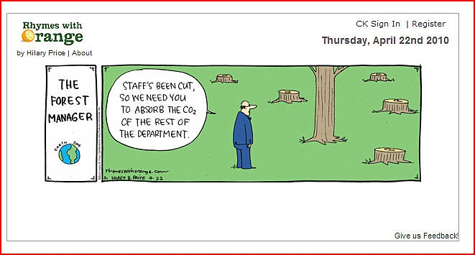

Slide 15
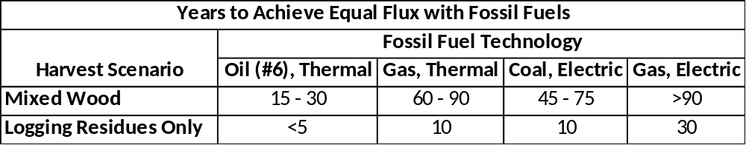
Manomet Study
Commissioned by the State of Massachusetts to examine carbon and forest cutting impacts of biomass power
When using whole trees as fuel, net CO2 emissions are greater than coal emissions for more than 45 years.

Slide 16
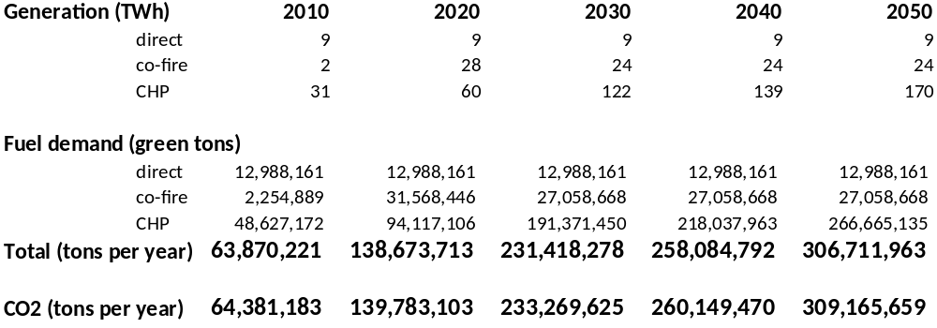
Any meaningful increase in biomass energy will require a large increase in whole-tree harvesting
USFS: ~100 million green tons of forestry residues generated each year; ~25 – 30 million tons available?
EIA’s BAU biomass power build-out scenario

Slide 17
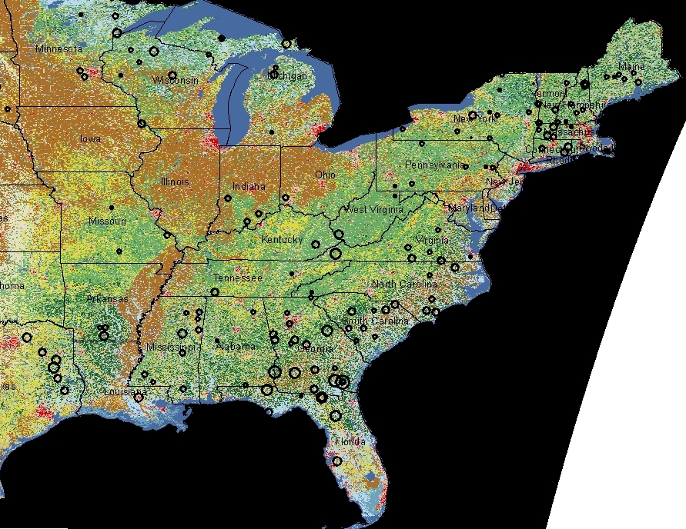
Proposed Facilities:
Biomass energy, wood pellet, and ethanol using wood as feedstock

Slide 18
Examples of facilities that will use whole trees for fuel
Laidlaw plant, Berlin NH: 70 MW
  ~850,000 green tons/yr
  113 tons “whole log” chips/hr
Russell Biomass, Russell, MA: 50 MW
  ~630,000 green tons/yr
  “The expected total volume of whole tree fuel to be purchased will be 250,000-350,000 tons per year.”
Beaver Wood Energy/Pellet plant, Fair Haven, VT: 34 MW, + 115,000 tons pellets
  ~600,000 green tons/yr

Slide 19
Biogenic Emissions make federal emission reduction goals impossible to meet: ACESA projections
3% reduction from 2006
14% reduction from 2006
environmental Working Group, “Clearcut Disaster”

Slide 20
The problem is international
Euroactiv, April 2, 2012:
Biomass 'insanity' may threaten EU carbon targets
“We’re paying people to cut their forests down in the name of reducing greenhouse gas emissions, and yet we are actually increasing them. No-one is apparently bothering to do any analysis about this,” one Brussels insider told EurActiv.
“They’re just sleepwalking into this insanity”.

Slide 21

mbooth@pfpi.net

